Slide 1
Moderation App
Parjita Munshi

Slide 2

Background and Implementation
Need to build a deep model to moderate comments posted by users on your blog site and tag them as either normal or toxic. If a comment is toxic, then provide reasons why it is such. Is it any of sexually explicit, hurting a minority or religious community, offensive to the LGBTQ community, derogatory remarks on physical appearance, and bashing cast and creeds?
Implement three different models for text classification: Random Forest Classifier, LSTM Model, and Multinomial Naive Bayes.
Dataset contains columns:
Toxic
severe_toxic
Obscene
Threat
Insult
indentity_hate

Slide 3

Approach 1 Random Forest Classifier and LSTM Model
Text classification model using both a Random Forest Classifier and an LSTM model. Used LIME for explaining the predictions of the LSTM model.

Slide 4
Methodology
Data Loading:
TF-IDF Vectorization: The comments are converted into numerical vectors using TF-IDF vectorization.
Random Forest Classifier: A MultiOutputClassifier with a RandomForestClassifier as the base estimator is trained on the TF-IDF transformed data for multi-label classification.
LSTM Model: A simple LSTM (Long Short-Term Memory) neural network is defined using Keras. It takes TF-IDF sequences as input and outputs predictions for the same categories.
Training and Evaluation:
Input and Prediction:The user is prompted to enter a comment. The TF-IDF representation of the user's comment is then fed into both the trained Random Forest and LSTM models to make predictions.
LIME Explanation for LSTM Model: LIME (Local Interpretable Model-agnostic Explanations) is used to provide an explanation for the LSTM model's prediction on the user's comment. LIME generates an interpretable model to explain the predictions of complex models.

Slide 5
Random Forest Classifier:
The code trains a MultiOutputClassifier using a RandomForestClassifier and evaluates it using the classification report. The output will show precision, recall, and F1-score for each category.
LSTM Model:
The code defines and trains an LSTM model for comment moderation. The training process is displayed with epochs, loss, and accuracy.
The model is then evaluated using the classification report, displaying precision, recall, and F1-score for each category.
LIME Explanation:
The code uses LIME (Local Interpretable Model-Agnostic Explanations) to explain the predictions of the LSTM model on a specific user comment. The explanation includes prediction probabilities for each category.

Slide 6
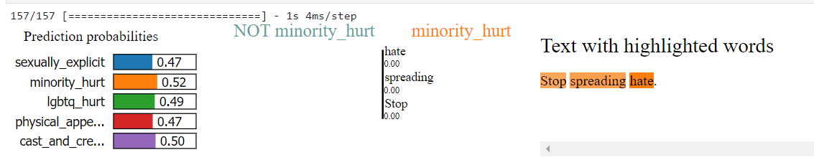
Result

Slide 7
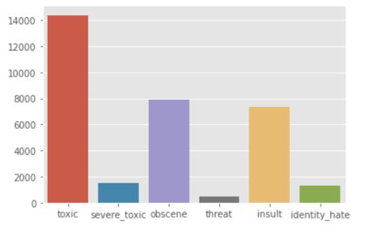
Approach 2 Multinomial Naive Bayes Model
This Approach showcases toxicity classification using a Multinomial Naive Bayes model.

Slide 8

Methodology
Data Loading and Visualization:
Text Cleaning:
Text Vectorization:Uses TfidfVectorizer to convert the text data into numerical format.
Model Training:Utilizes a Multinomial Naive Bayes model for toxicity classification using the OneVsRestClassifier.
Prints accuracy and classification report for the model.
Threshold Adjustment:Evaluates the impact of different threshold values on precision, recall, and F1-score.
Confusion Matrix Visualization:
Classification Report Visualization:

Slide 9
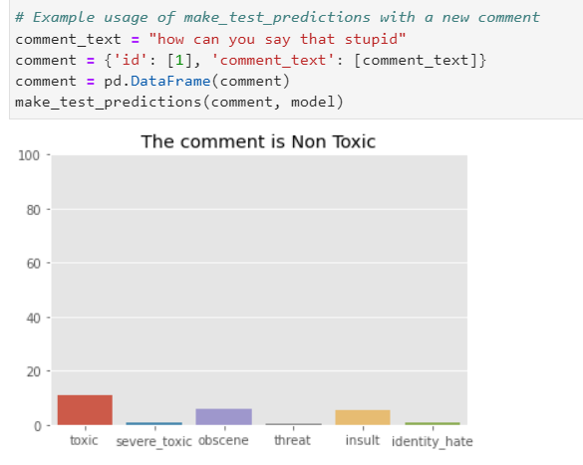
Result
Prediction on New Comments:
Defines a function make_test_predictions to predict toxicity for new comments.
Utilizes the trained model to predict and visualize the toxicity probability for two example comments.

Slide 10
Conclusion
Model Training is fast
Highly capable to predict non-toxic comments
Not giving perfect output in toxic behaviours
Model is too weak to perform this task.

Slide 11

Approach 3 LSTM Model with Text Vectorization
This Approach represents a text classification model for toxicity moderation using a recurrent neural network (RNN) with LSTM layers implemented in TensorFlow. The overall approach involves several key steps:

Slide 12

Data Processing:
Preprocess the text data.
Dataset Preparation:
Model Architecture:
Display toxic categories if prediction surpasses a specified threshold.
Model Compilation and Training:
Model Evaluation:
Saving and Loading Model:
User Interaction:
Load a dataset with comment text and toxicity labels.
Text Vectorization:
Utilize TensorFlow's TextVectorization layer for converting text to numerical format.
Create a TensorFlow Dataset with vectorized text and toxicity labels.
Build a sequential neural network with embedding, bidirectional LSTM, and dense layers.
Use sigmoid activation for binary toxicity label classification.
Compile the model with binary cross-entropy loss and Adam optimizer.
Train on the training dataset with validation.
Evaluate the model on the test set, print test loss, and accuracy.
Save the trained model and load it for future use.
Take user input, vectorize, and predict toxicity.
LIME Implementation:
Find weighatge of word which contribute more to recognize comment is toxic or not

Slide 13
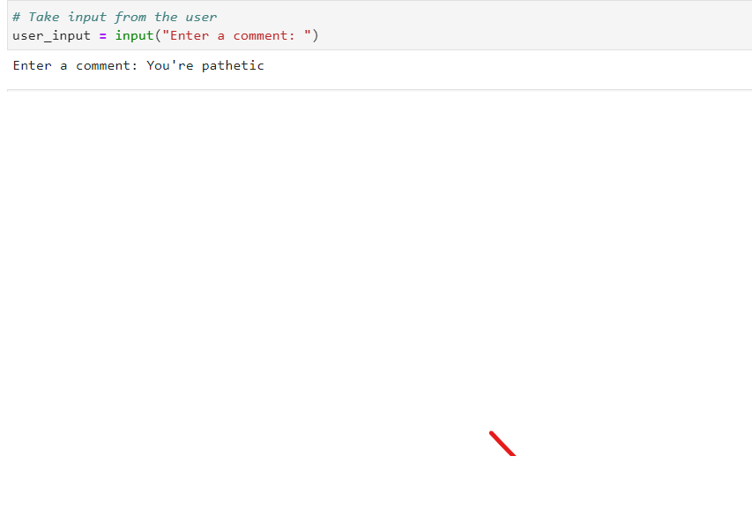
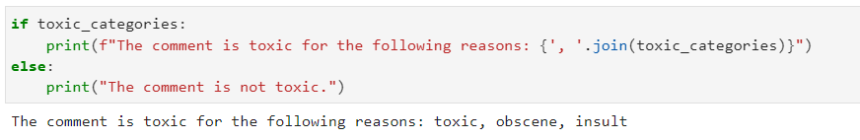
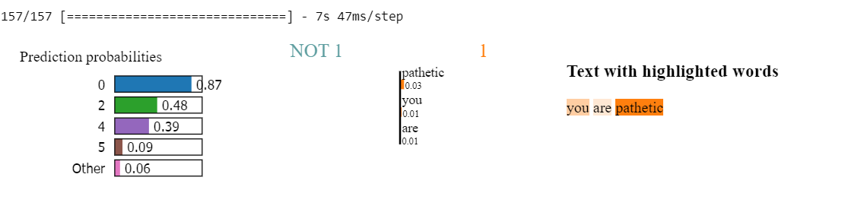
Output

Slide 14
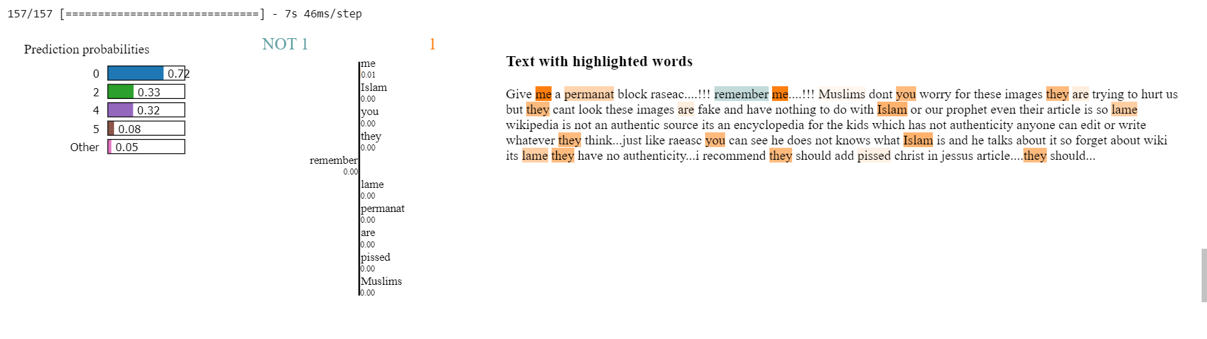
Work on Paragraph

Slide 15

Conclusion
The model exhibits high accuracy during evaluation on the test set, indicating its proficiency in identifying toxic content in comments.
The impact of adjusting the prediction threshold is observed, change in precision, recall, and overall model performance.
Taking a lot time to train 1 epoch

Slide 16
Final Output and Findings
High model complexity makes model more accurate.
Random Forest Classifier:
Achieved high precision and recall across toxic categories.
Robust performance and relatively easy interpretability.
Considerable accuracy, making it a strong candidate for toxic comment classification.
Multinomial Naive Bayes Model:
Displayed competitive accuracy, especially with optimized threshold values.
Efficient and interpretable, suitable for applications where simplicity is a priority.
Consider threshold optimization for improved precision and recall.

Slide 17
If interpretability and efficiency are crucial, consider Random Forest or Naive Bayes.
01
If capturing complex patterns is a priority and computational resources are available, the LSTM models are competitive.
02

Slide 18

Thank You

